Slide 1

SERVERLESS
.NET Applications on AWS. Databases

Slide 2

AGENDA —
Serverless | . . . . . . . . . . . . . . . . . . . . . . . . . . . . . . . . . . . . . . | 02
Amazon DynamoDB | . . . . . . . . . . . . . . . . . . . . . . . . . . . . . . . . . . . . . . | 07
Amazon Aurora Serverless | . . . . . . . . . . . . . . . . . . . . . . . . . . . . . . . . . . . . . . | 18
AWS Lambda and other services | . . . . . . . . . . . . . . . . . . . . . . . . . . . . . . . . . . . . . . | 28
Application Overview | . . . . . . . . . . . . . . . . . . . . . . . . . . . . . . . . . . . . . . | 54
Practice | . . . . . . . . . . . . . . . . . . . . . . . . . . . . . . . . . . . . . . | 56

Slide 3
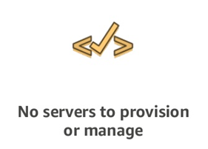
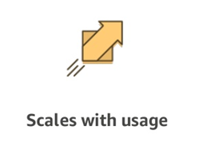
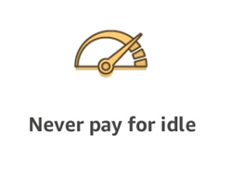
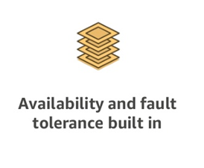
A SERVERLESS WORLD … —

Slide 4
SERVERLESS PROS
SERVERLESS CONS
No server management
Flexible Scaling
Pay for value
High availability
Time to market
“Greener” computing
Vendor control
Complexity
Configuration, deployment
Testing and Debugging

Slide 5
SERVERLESS. AWS Services —
COMPUTE AWS Lambda Lambda@Edge AWS Fargate | STORAGE S3 EFS | DATA STORES DynamoDB Aurora Serverless | ORCHESTRATION Step Functions
MESSAGING SNS SQS | API PROXY API Gateway | ANALYTICS Kinesis Athena | DEVELOPER TOOLING SAM X-Ray, Cloudwatch Codestar Codepipeline Codebuild Codedeploy Cloud9

Slide 6

Amazon DynamoDB —

Slide 7
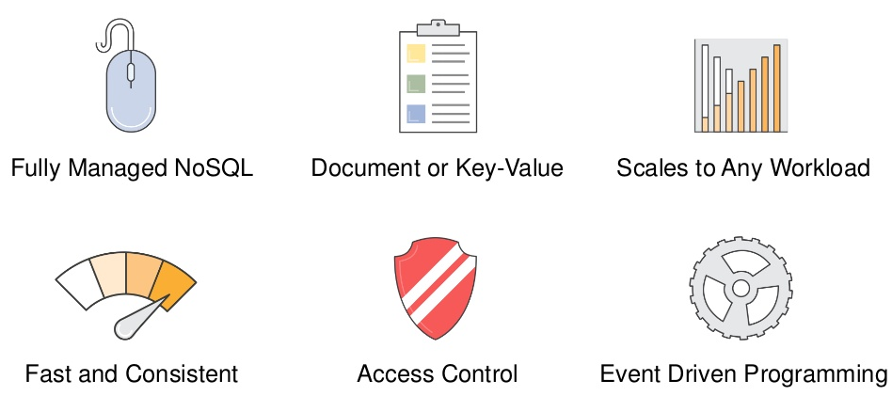
Amazon DynamoDB —

Slide 8
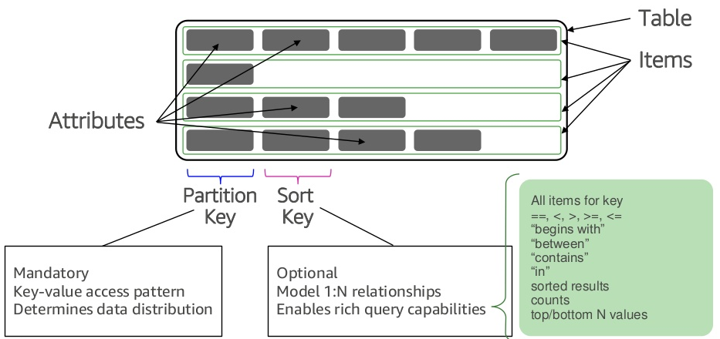
Amazon DynamoDB. Tables —

Slide 9
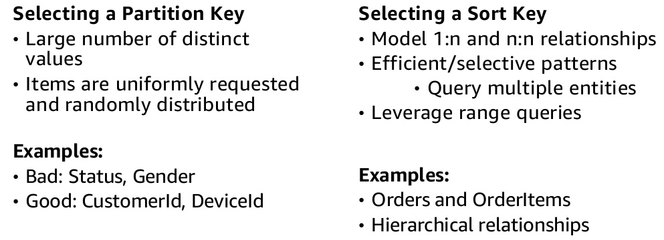
Amazon DynamoDB. Key Concepts —

Slide 10
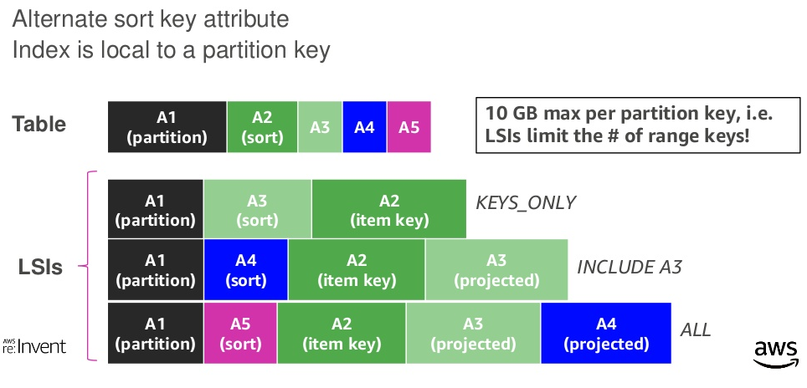
Amazon DynamoDB. Local Secondary Index (LSI) —

Slide 11
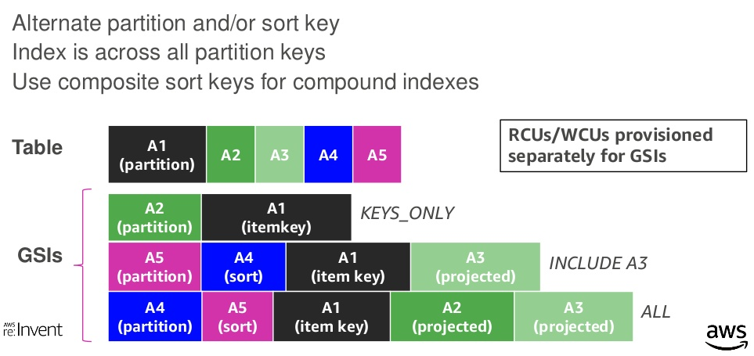
Amazon DynamoDB. Global Secondary Index (GSI) —

Slide 12
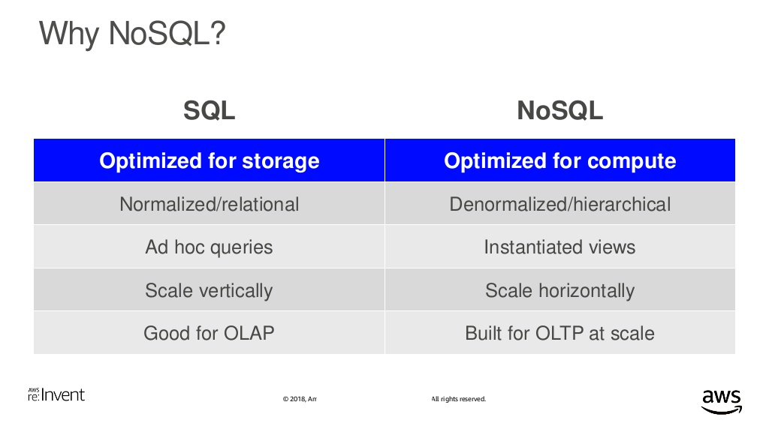
Amazon DynamoDB —

Slide 13
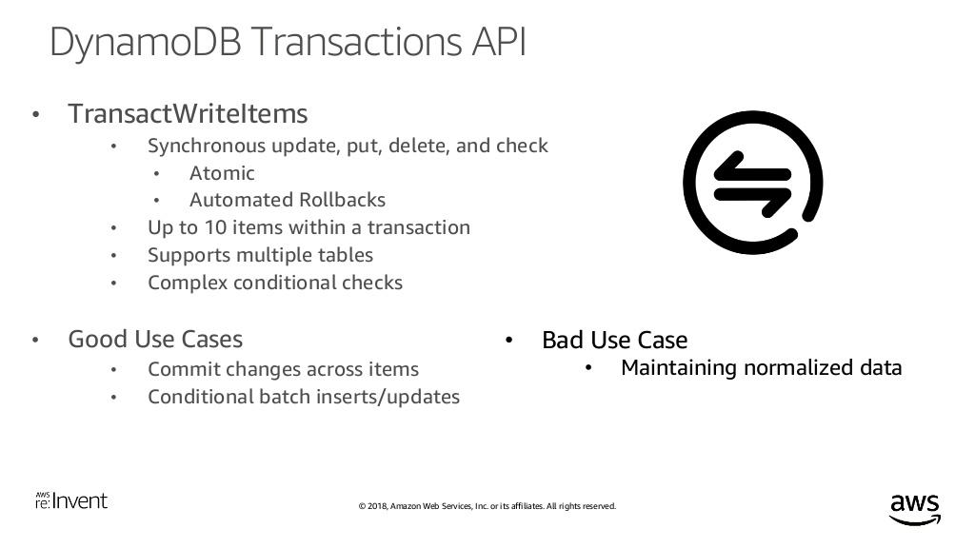
Amazon DynamoDB —

Slide 14
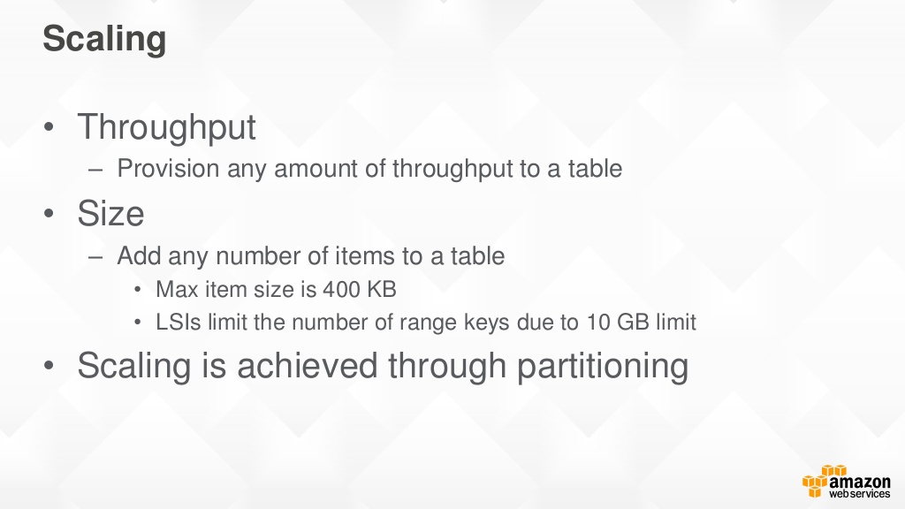
Amazon DynamoDB —

Slide 15
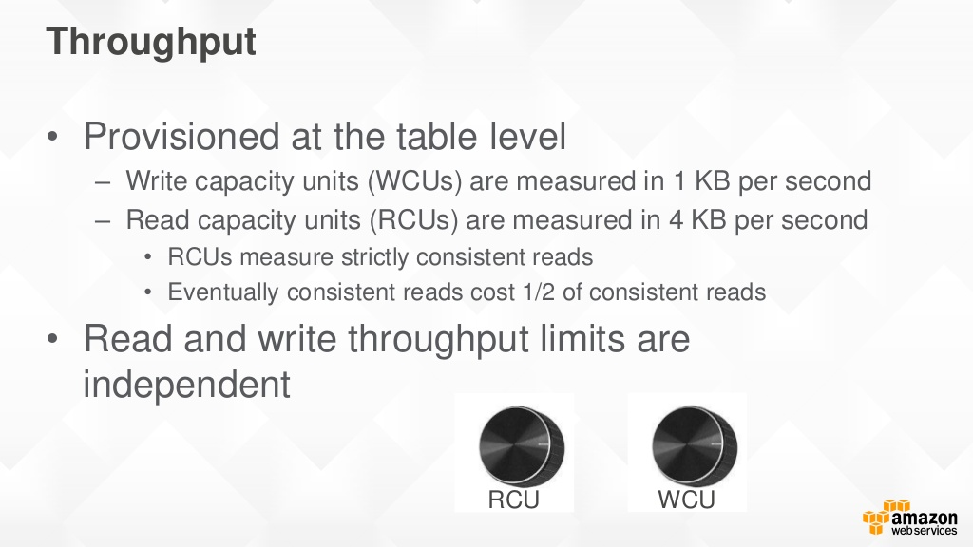
Amazon DynamoDB —

Slide 16
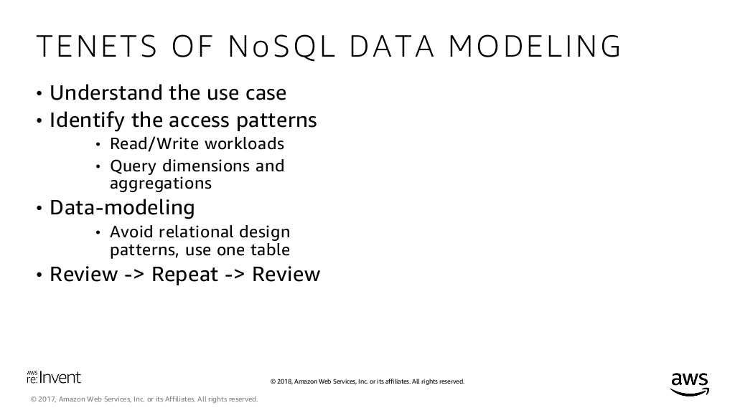
Amazon DynamoDB. Data Modeling —
Basics
Start with an ERD
2. Define your access patterns
3. Design your primary key & secondary indexes

Slide 17
Amazon DynamoDB. Features —
Key-value and document data models
DynamoDB Accelerator (DAX)
Global tables
Data Streams for DynamoDB
Read/write capacity modes
On-demand mode
Auto scaling
Change tracking with triggers
ACID transactions
Encryption at rest
Point-in-time recovery
On-demand backup and restore

Slide 18
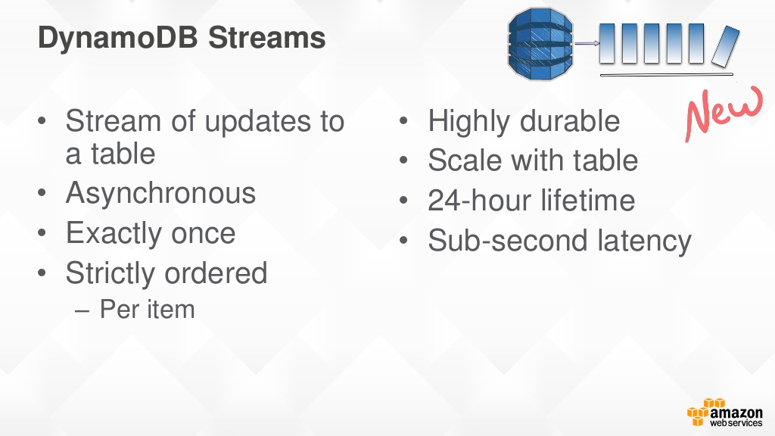
Amazon DynamoDB. Streams —

Slide 19
Amazon DynamoDB —

Slide 20

Amazon Aurora Serverless —

Slide 21
Amazon Aurora Serverless. Database Compute —

Slide 22
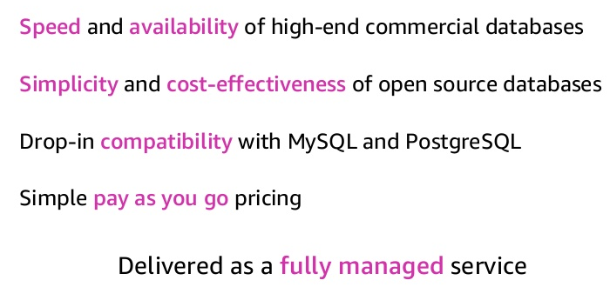
Amazon Aurora Serverless —

Slide 23
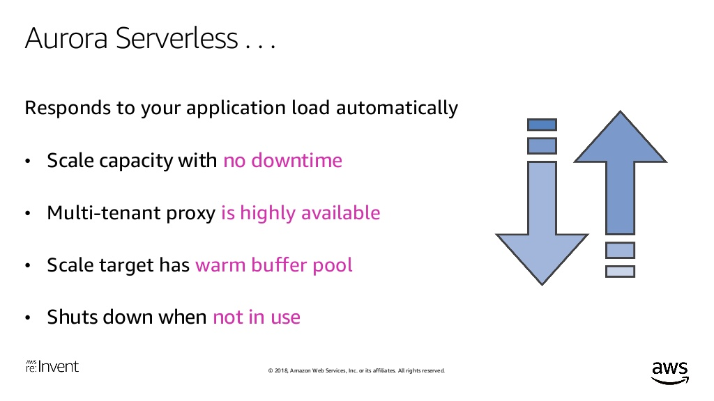
Amazon Aurora Serverless —

Slide 24
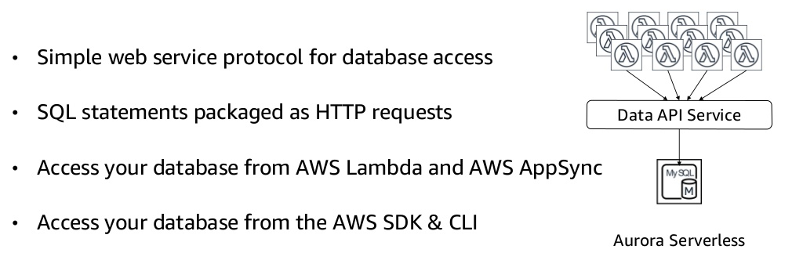
Amazon Aurora Serverless. Data API —

Slide 25
Amazon Aurora Serverless. Benefits —
HIGHLY SCALABLE
HIGHLY AVAILABLE
COST-EFFECTIVE
SIMPLE
TRANSPARENT
DURABLE

Slide 26
Amazon Aurora Serverless. Use Cases —
Variable workloads
Unpredictable workloads
Enterprise database fleet management v2
Software-as-a-Service applications v2
Scaled-out databases split across multiple servers v2

Slide 27
Amazon Aurora Serverless —

Slide 28

AWS Lambda —

Slide 29
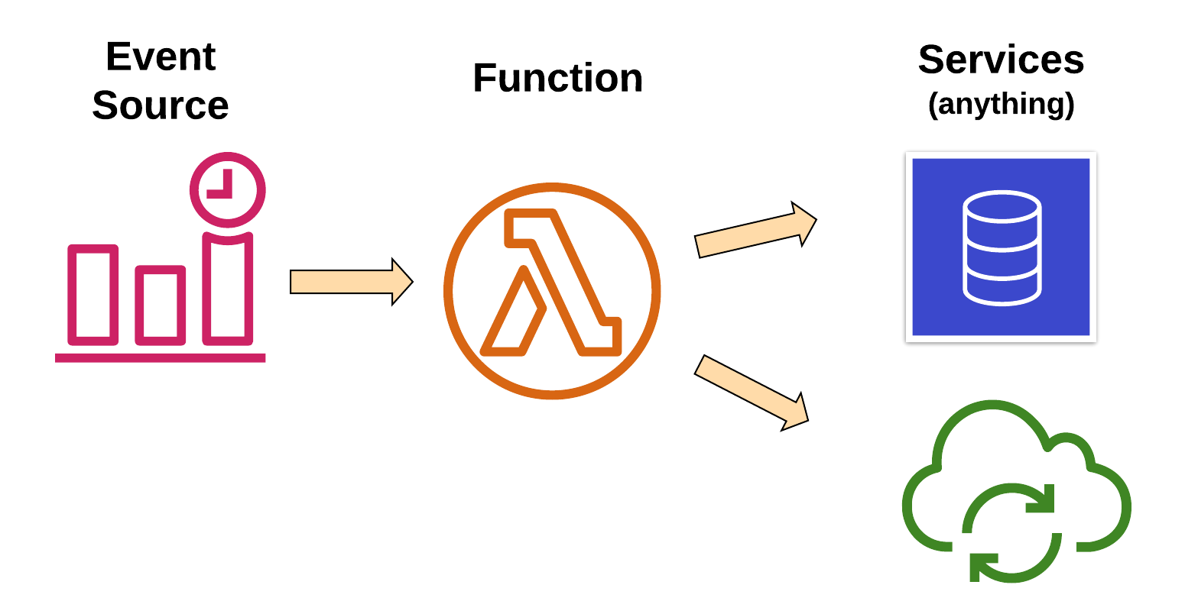
AWS Lambda. Overview —
Changes in data state
Requests to endpoints
Changes in resource state
Node.js, Python
Java, C#, Go, Ruby
Custom Runtime

Slide 30
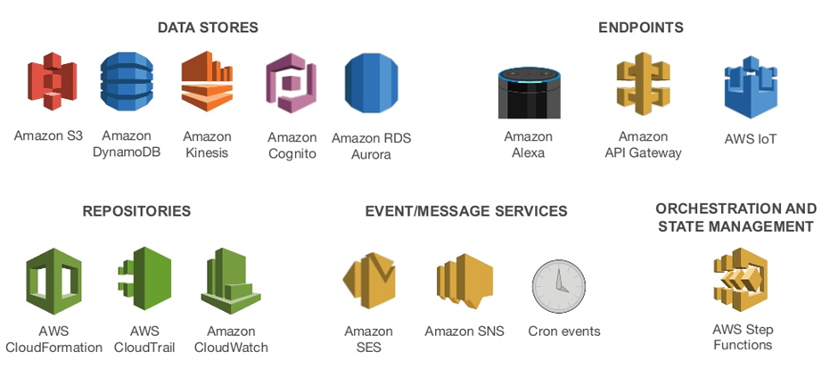
AWS Lambda. Event Sources —

Slide 31
AWS Lambda. Anatomy —
Handler() function
Function to be executed upon invocation
Event object
Data sent during Lambda function invocation
Context object
Methods available to interact with runtime information (request ID, log group, more)
public async Task FunctionHandler(S3Event input, ILambdaContext context)
{
foreach(var record in input.Records)
{
….
}
}

Slide 32
AWS Lambda. Handle —
Load Balancing
Auto Scaling
Handling Failures
Security Isolation
OS Management
Managing Utilization

Slide 33
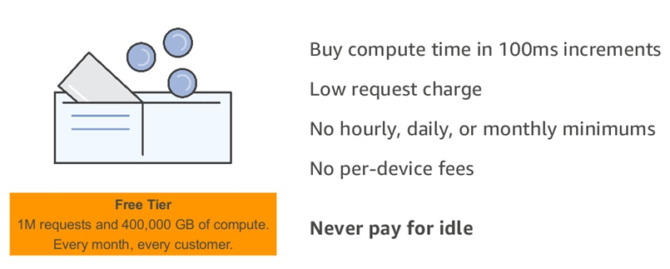
AWS Lambda. Fine-grained Pricing —
Requests | $0.20 per 1M requests
Duration | $0.0000166667 for every GB-second

Slide 34
AWS Lambda. Limits —
Concurrent executions | 1,000
Function and layer storage | 75 GB
Elastic network interfaces per VPC | 250
Function memory allocation | 128 MB to 3,008 MB, in 64 MB increments.
Function timeout | 900 seconds (15 minutes)
Function environment variables | 4 KB
Function resource-based policy | 20 KB
Function layers | 5 layers
Function burst concurrency | 500 - 3000 (varies per region)
Invocation frequency (requests per second) | 10 x concurrent executions limit (synchronous) 10 x concurrent executions limit (asynchronous – non-AWS sources) Unlimited (asynchronous – AWS service sources)
Invocation payload (request and response) | 6 MB (synchronous) 256 KB (asynchronous)
Deployment package size | 50 MB (zipped, for direct upload) 250 MB (unzipped, including layers) 3 MB (console editor)
Test events (console editor) | 10
/tmp directory storage | 512 MB
File descriptors | 1,024
Execution processes/threads | 1,024

Slide 35

AWS API Gateway —

Slide 36




AWS API Gateway —
Create a unified API frontend for multiple micro-services
DDoS protection and throttling for your backend
Authenticate and authorize requests to a backend
Throttle, meter, and monetize API usage by third-party developers

Slide 37
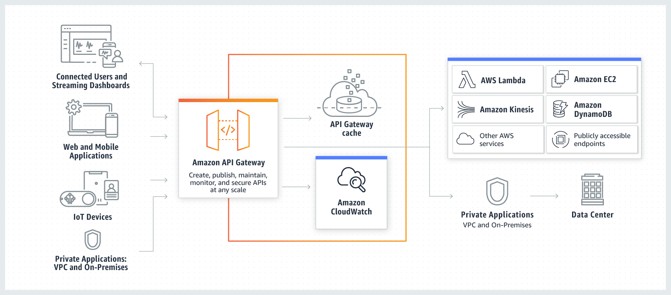
AWS API Gateway. Overview —

Slide 38
AWS API Gateway. Types —
API RESTful
API WEBSOCKET

Slide 39
AWS API Gateway. Features —
Host multiple versions and stages of your APIs
Create and distribute API Keys
Secure API
Throttle and monitor requests to protect your backend
Managed cache to store API responses
Reduced latency and DDoS protection through CloudFront
SDK Generation for iOS, Android and JS
Swagger and Open API support
Request/Response data transformation and API mocking

Slide 40
AWS API Gateway. Meter Usage —
Create API Keys
Combine them into Usage Plans
Set access permissions at the API/Stage level
Meter usage of API Keys through CloudWatch Logs

Slide 41
AWS API Gateway. Pricing —
FREE TIER
1M REST API CALLS RECEIVED | 1M HTTP API CALLS RECEIVED | 1M MESSAGES | 750,000 CONNECTION MINUTES
HTTP API Calls
First 300 million - $1
300+ - $0.9
REST API
First 333 million - $3.5
Over 20 billion - $1.51
Caching
58.2 GB - $1 per hour
WEBSOCKET API
First 1 billion - $1 per million
$0.25 per million connection minutes

Slide 42
AWS API Gateway. Limits —
Resource or Operation | Default Quota | Can Be Increased
Routes per API | 300 | Yes
Integrations per API | 300 | No
Maximum integration timeout | 30 seconds | No
Stages per API | 10 | Yes
Tags per stage | 50 | No
Total combined size of request line and header values | 10240 bytes | No
Payload size | 10 MB | No
Custom domains per account per Region | 120 | Yes
Access log template size | 3 KB | No
Amazon CloudWatch Logs log entry | 1 MB | No
Authorizers per API | 10 | Yes
Audiences per authorizer | 50 | No
Scopes per route | 10 | No
Timeout for JSON Web Key Set endpoint | 1500 ms | No
Timeout for OpenID Connect discovery endpoint | 1500 ms | No
VPC links per account per Region | 10 | Yes
Subnets per VPC link | 10 | Yes
Stage variables per stage | 100 | No

Slide 43

AWS Cognito —

Slide 44

AWS Cognito. Overview —
User Identity
Authentication
Authorization
User Management
Sign in users
Federation with enterprise identities
Federation with social identities
Standards-based (Oauth, SAML, OpentID)
Protect data and operations
Provide fine-grained access control
Manage user lifecycles
Store and manage user profile data
Monitor engagement

Slide 45
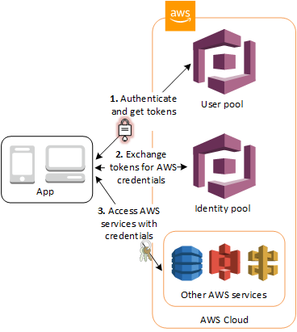
AWS Cognito. Overview —
User Pools
Domain
App Client
Resource Server
Identity Pools
Cognito Sync

Slide 46
AWS Cognito. User Pools —
Sign-up and sign-in services
A built-in, customizable web UI
Social sign-in - Facebook, Google, Amazon, SAML and OIDC.
User directory management and user profiles
Security features - MFA, checks for compromised credentials, account takeover protection, and phone and email verification
Customized workflows and user migration through AWS Lambda triggers

Slide 47
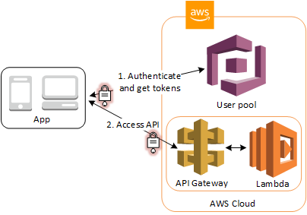
AWS Cognito. Native Support —
API Gateway Authorizers
ALB Authorizers

Slide 48

AWS CloudFormation —

Slide 49
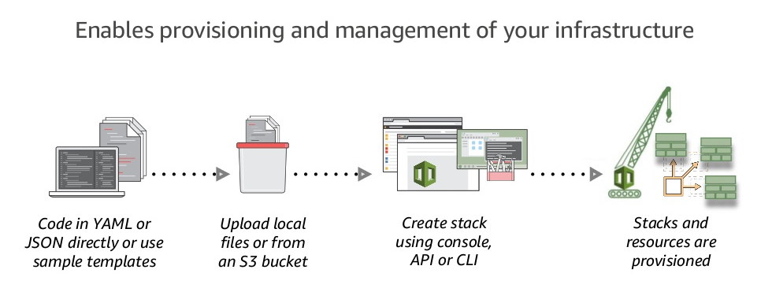
AWS CloudFormation at a Glance —

Slide 50
AWS CloudFormation. Features —
Native AWS Technology
Logical Components Relationship
Visualization
Rollbacks Support
Resources Cleanup
Preview Changes
Costs Trekking
Integration with other AWS Services
Safety Controls
Extensibility

Slide 51
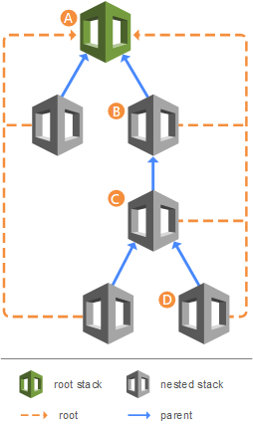
AWS CloudFormation. Stacks —
Create Deployment Stacks
Create Change Sets
Detect Changes
Nested Stacks
Stack Sets
CF CLI

Slide 52
AWS CloudFormation. Benefits and Tools —
Unify Deployment
Detect Changes
CDK
ClaudFormation Macroses
Infrastructure Tests/Validation Pipeline
AWS Serverless Application Repository
Different Deployment Types - Green/Blue, Canary, A/B Testing
AWS Service Catalog

Slide 53

AWS CloudFormation. SAM —
AWS CloudFormation extension or “transform”
Optimized for serverless apps
Serverless resource types: functions, APIs, tables
Support anything AWS CloudFormation support
SAM CLI

Slide 54

AWS CloudFront —

Slide 55
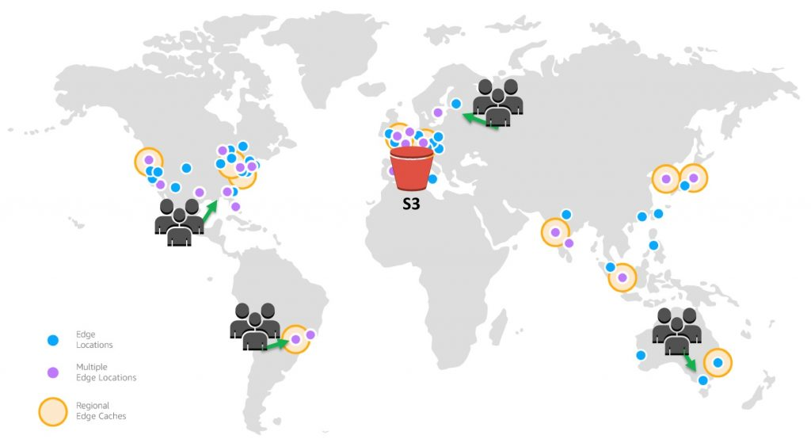
AWS CloudFront —

Slide 56
AWS CloudFront. Features —
Global Amazon Infrastructure
Security
Availability
Performance
Programmable and DevOps Friendly
Lambda@Edge
Cost Effective

Slide 57

AWS CloudWatch —

Slide 58
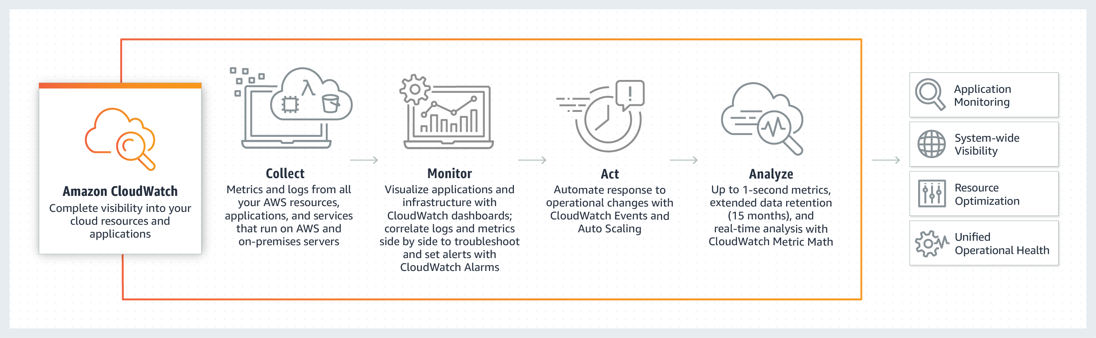
AWS CloudWatch. Overview —

Slide 59
AWS CloudWatch. Features —
Collect
Store logs and Build-in or custom metrics
Monitor
Operational dashboards
High resolution alarms, anomaly detection
Application Insights for .NET and SQL Servers apps
Act
Auto Scaling and CloudWatch Events
Analyze
Compliance and Security

Slide 60
APPLICATION OVERVIEW —
DEMO

Slide 61
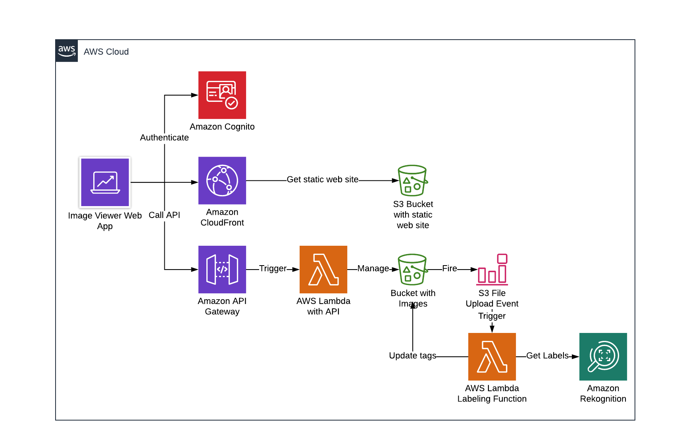
APPLICATION OVERVIEW —

Slide 62
PRACTICE —
https://github.com/illiasaveliev/image-viewer

Slide 63
THANK YOU!

